Slide 2
Track B: rapporteur highlights
Laura Waters
Mortimer Market Centre, CNWL, London, UK
@drlaurajwaters
Share your thoughts on this presentation with #IAS2019

Slide 3
Disclosures
Speaker/advisory fees
Gilead, ViiV, MSD, Janssen, Cipla, Mylan
Research funding
Gilead, Janssen, ViiV
Sleepless in Mexico City

Slide 4
What is a rapporteur?

Slide 5
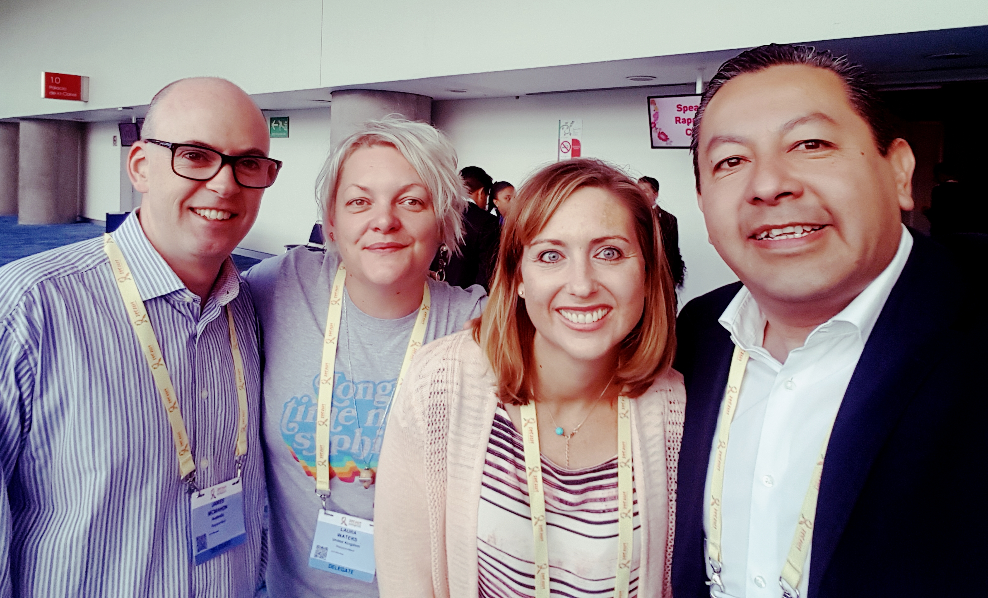
Team B!
James McMahon
Colleen Kelley
Luis Mosqeueda

Slide 6
Sexually transmitted infections & PrEP
Rise preceded PrEP & is not a reason to withhold it!
Antibiotic prophylaxis?
Do not use single dose azithromycin for any STI!
TUPDC01: Mycoplasma genitalium most frequent STI in German MSM
DISCOVER (TUAC04 ):
Expected PK, efficacy & adverse event assertions premature
We should be expanding access to affordable PrEP globally

Slide 7
Cascades of care
Differences in definitions may limit comparability
Focused subpopulation cascades are essential to identify barriers for underserved populations
“why are we asking relatively well people to attend clinics – only clinicians think that’s fun” Gloria Maimela MOPL0102

Slide 8
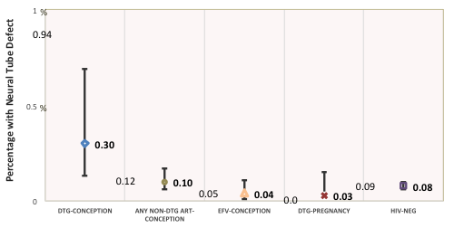
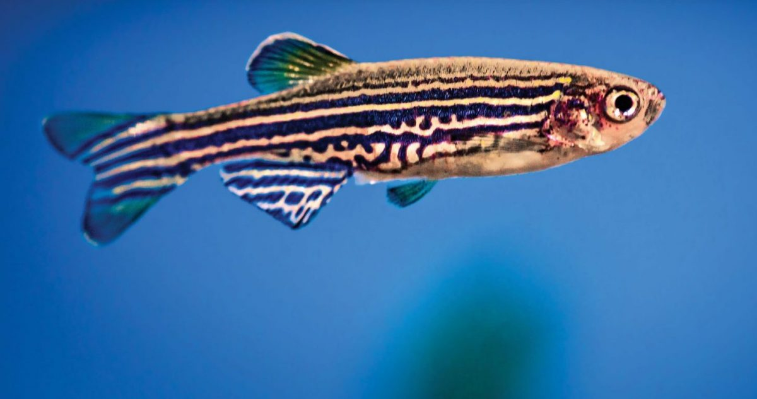
Pre-conception dolutegravir & NTDs
Cons of alternatives:
Protease inhibitors & PTD
Models showing more virological failure & transmission on EFV vs DTG
Brazil cohort
No NTDs in 382 pregnancies
APR update
0.03% overall
0.40% DTG (1 NTD)
0.14% for InSTI class
www.APRegistry.com
Tsepamo cohort
Community engagement!
Little/none initially
INFORMED CHOICE
NTDs/Exposures | 5/1683 | 15/14792 | 3/7959 | 1/3840 | 70/89372
% with NTD (95% CI) | 0.30% (0.13, 0.69) | 0.10% (0.06, 0.17) | 0.04% (0.01, 0.11) | 0.03% (0.0, 0.15) | 0.08% (0.06, 0.10)
Prevalence Difference (95% CI) | ref | 0.20% (0.01, 0.59) | 0.26% (0.07, 0.66) | 0.27% (0.06, 0.67) | 0.22% (0.05, 0.62)
Access to effective contraception

Slide 9
ECHO: typical use pregnancy incidence
Method | aHR (95% CI)* | p-value
DMPA-IM v. Copper IUD | 0.80 0.49-1.31 | 0.375
DMPA-IM v. LNG implant | 1.39 0.80-2.45 | 0.246
IUD v. LNG implant | 1.74 1.01-2.99 | 0.044
*Adjusted for no condom use with last vaginal sex
Pregnancy incidence per 100 WY; Pregnancies (n)
1.11 (95%CI 0.77-1.54); n=35
0.87 (95%CI 0.58-1.25); n=29
0.63 (95%CI 0.39-0.96); n=21
Notes:
This slide presents findings for the typical use analysis.
The figure on the left shows the cumulative incidence curves for typical use which is somewhat similar to what we saw in the perfect use curves
Since typical use incorporates time when women were temporarily off her method, the pregnancy incidence per 100 WY is greater as you can see in the numbers on the right
In adjusted models-typical use of copper IUD was associated with a statistically significant higher risk of pregnancy compared to LNG implants with an aHR of 1.74. The other comparisons did not reach statistical significance

Slide 10
Reflate TB2: 1st line ART with standard TB treatment TDF/3TC + RAL 400 BID vs TDF/3TC + EFV 600 OD (n=230/arm)
EFV arm
RAL arm
Treatment Difference (95% CI): RAL - EFV
Lessons:
Ph2 promise may not translate to Ph3
Differences may emerge after week 24
-12% NI margin
1/3: CD4 <50
3/4: VL >100k
Non-inferiority
criteria not met
-13.9
3.7
-5.1
-12
-8
-4
0
4
8

Slide 11
DOLUTEGRAVIR: EFFICACY & WEIGHT
ODYSSEY: DOLUTEGRAVIR PK ANALYSIS IN CHILDREN 6-20kg

Slide 12
GEMINI: DTG+3TC non-inferior to TDF/FTC+DTG snapshot VL<50 at W96
No emergent resistance
Snapshot
Treatment | Responders, n (%) | Adjusted difference, % (95% CI)ª
DTG + 3TC | 616/716 (86.0) | −3.4 (−6.7, 0.0)
DTG + TDF/FTC | 642/717 (89.5)
DTG + 3TC | 692/716 (96.6) | 0.2 (−1.8, 2.2)
DTG + TDF/FTC | 691/717 (96.4)
Snapshot
TRDF
0
4
8
12
16
24
36
48
60
72
84
96
Non-inferiority criteria were met for GEMINI-1, GEMINI-2, and the pooled analysis
Treatment related discontinuation = failure (TRDF) population accounts for confirmed virologic withdrawal, withdrawal due to lack of efficacy, withdrawal due to treatment-related AE, and protocol-defined stopping criteria
Cahn et al. IAS 2019; Mexico City, Mexico. Slides WEAB0404LB.
12

Slide 13
TANGO: DTG/3TC non-inferior to TAF 3DR at W48
Virologic outcomes
Adjusted treatment difference (95% CI)^{b}
DTG/3TC
TAF-based regimen
No emergent resistance
Primary endpoint:
DTG/3TC non-inferior to TAF-based regimen (≥50 c/mL) at Week 48
4% non-inferiority margin
TAF-based regimen
DTG/3TC
Key secondary endpoint: DTG/3TC non-inferior to TAF-based regimen (<50 c/mL) at Week 48
-8% non-inferiority margin
ª
Difference, %
In the per-protocol population, 0/352 participants in the DTG/3TC group and 2/358 participants in the TAF-based regimen group had HIV-1 RNA ≥50 c/mL at Week 48 (adjusted difference, −0.6; 95% CI, −1.3 to 0.2) ^{b}
ªPrimary endpoint (Snapshot virologic non-response, ITT-E). ^{b}Based on Cochran-Mantel-Haenszel stratified analysis adjusting for baseline third agent class.
van Wyk et al. IAS 2019; Mexico City, Mexico. Slides WEAB0403LB.

Slide 14
ADVANCE, 1st line trial in South Africa
TAF/FTC+DTG
n = 351
1053
participants
TDF/FTC+DTG
n = 351
TDF/FTC/EFV
n = 351
96W
60% female, ≈100% Black
Drawn from a group representing a quarter of the global epidemic
Notes:
15% baseline NNRTI resistance regionally

Slide 15
Proportion with VL<50 (ITT)
Strongest correlation in ITT: age/employment
Suppression aroung 60% for young unemployed
Approaching 100% for older, employed
OT analysis 95-96% suppression in all arms

Slide 16
Drivers of weight gain/loss on ART
DTG or BIC
Treatment naïve
Weight gain
Women
Black
PI
Weight loss
TDF
A Hill et al. Journal of Virus Eradication 2019
Notes:
Drivers of weight gain or loss on ART based on studies to date suggest that:
Larger increases in body weight were seen in ARV-naïve populations than in switch situations
InSTIs have been associated with weight gain, more with DTG and BIC than RAL or EVG. Data presented at CROI regarding cabotegravir showed no significant weight gain but this was among HIV-negatives in a PrEP study
Weight gain has also been seen with protease inhibitors but less severe
TDF is associated with weight loss in these studies compared to TAF, ABC and NRTI-sparing regimens
Weight gain was higher in women and black PLWH

Slide 17
Weight
NAMSAL 48 weeks (baseline BMI 23)
Significantly more weight/BMI gain & emergent obesity on TDF/3TC + DTG vs TDF/3TC/EFV400
ADVANCE 96 weeks (baseline BMI 22 in men, 27 in women)
TAF/F/DTG vs TDF/F/DTG vs TDF/FTC/EFV
Men +5kg, +4kg, +1kg (DEXA: similar fat/lean mass gain)
Women +10kg, +5kg, +3kg (DEXA: fat>lean mass gain)

Slide 18
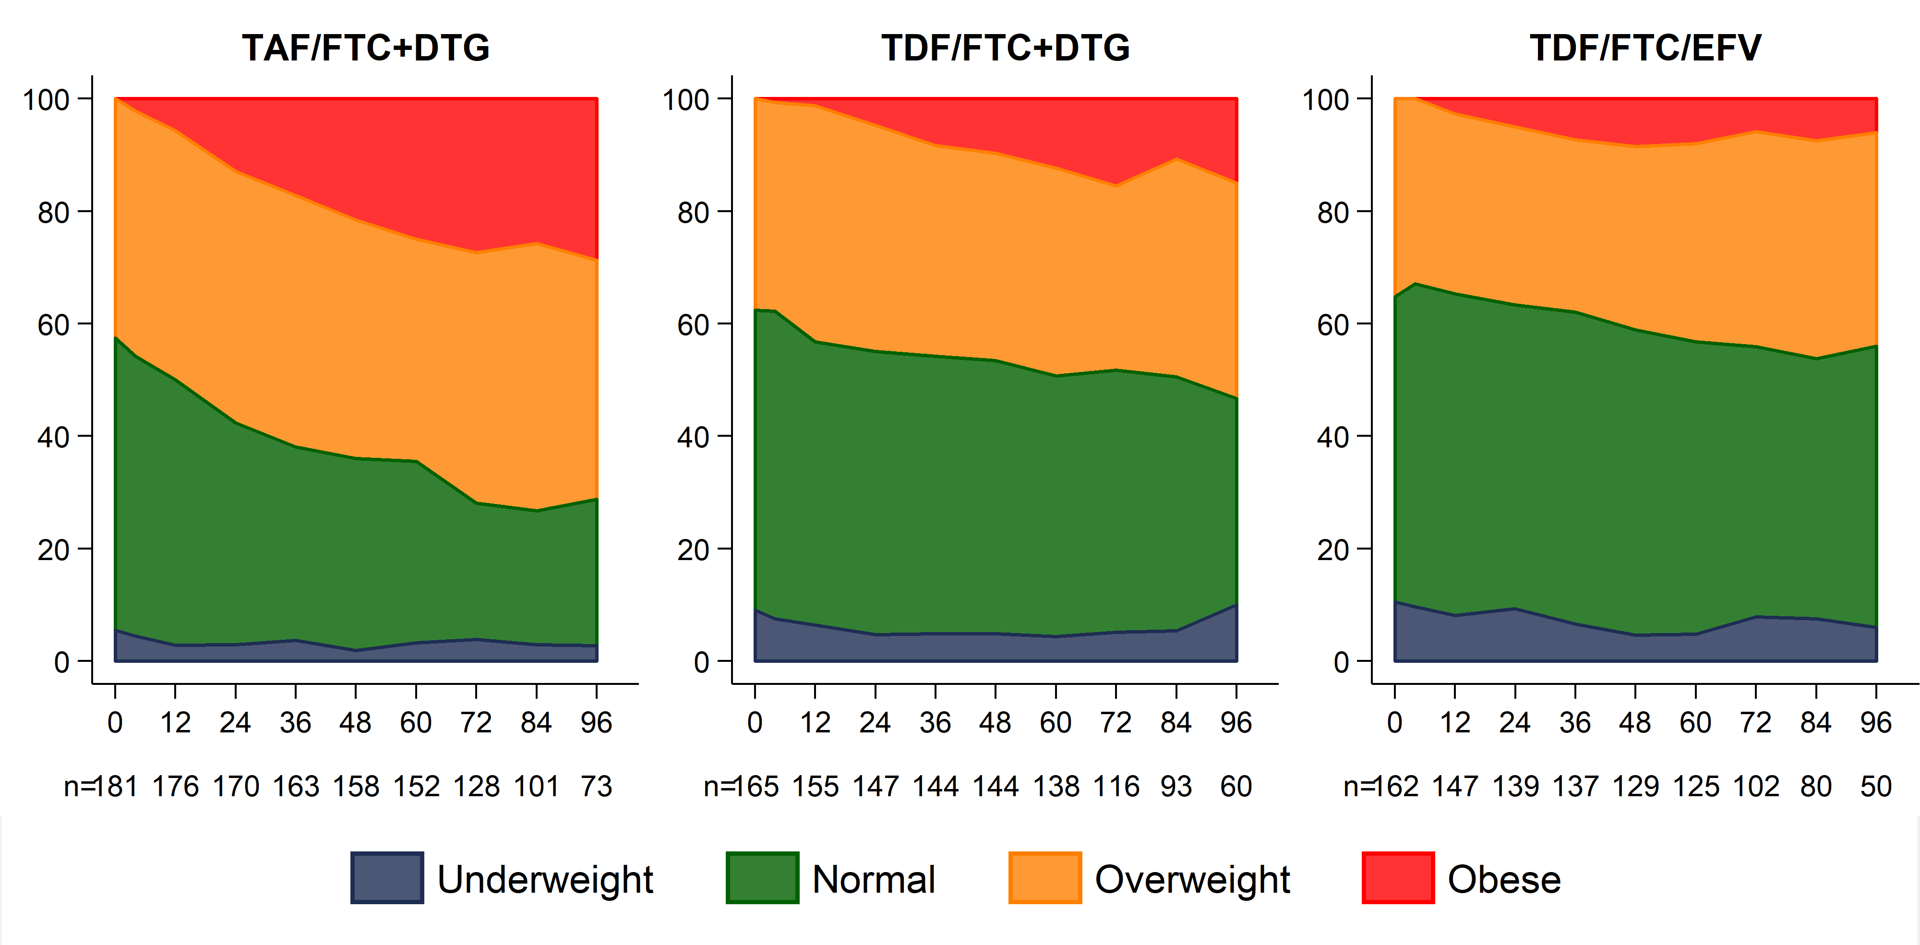
ADVANCE: BMI category over time: women (obese at baseline excluded)
% Participants
Notes:
Here we show changes in BMI category over 96 weeks for women in ADVANCE, with those who were obese at BL excluded from the analysis. More women receiving TAF/FTC+DTG became overweight or obese than the other 2 study arms: by week 96, almost 70% of women in the TAF/FTC+DTG were overweight or obese. More than 20% of women in the TAF/FTC+DTG arm became obese by week 96, compared to less than 20% in the TDF/FTC+DTG arm and less than 10% in the EFV-containing arm. There were more underweight women in the two TDF-containing arms, and this was relatively stable across the study.
At the time of the analysis, not all participants had reached week 96 of the study; accordingly the number of participants at each time point is represented.

Slide 19
NEW DRUGS

Slide 20
Very brief
Fostemsavir: BRIGHTE Study
Islatravir (MK-8591) 1st in class NRTTI
Phase 2 study: doravirine + 3TC + islatravir (0.25, 0.75 or 2.25mg) vs doravirine/TDF/3TC for 24 weeks, then drop 3TC in islatravir arms
Good viral suppression to W48, promising 2DR
GS-6207 capsid inhibitor: ph1 s/c d14 2.2 log VL after single dose
No drugs:
Cure strategies & analytical treatment interruption (ATI)
Implications for participants & their sexual partners
Engage community early & continuously in trial design & conduct
Notes:
No viral failures met criteria fro R testing as all had VL <80 on repeat

Slide 21
Access
“The future is here….but it’s our collective responsibility to deliver innovation EVERYWHERE, to EVERYONE including women & children” Professor Chloe Orkin, London (TUSY03)
The Medicines Patent Pool generic TLD to2.7 million PLHIV in 26 countries by December 2018 (TUSY0406)
Proposing to establish a Long-acting Technology Access Hub

Slide 22
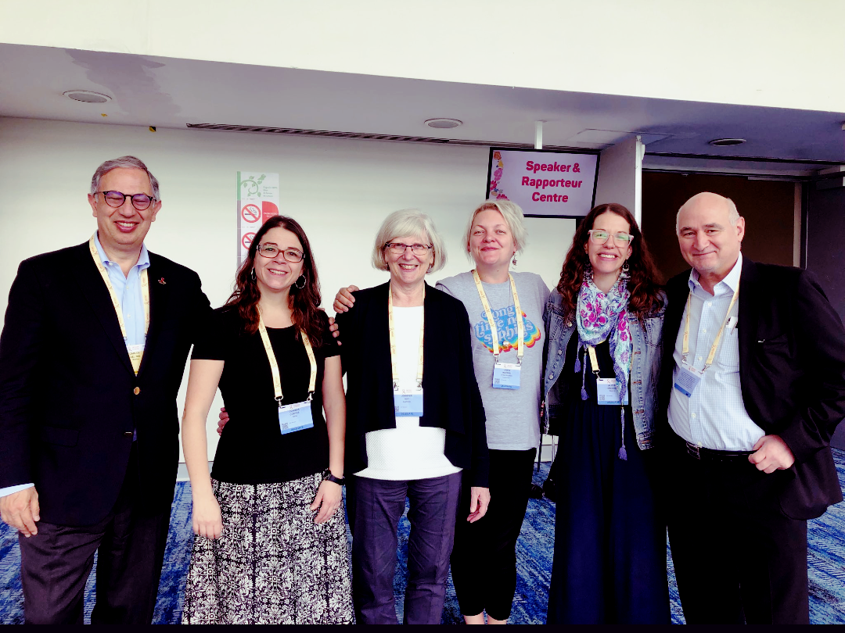
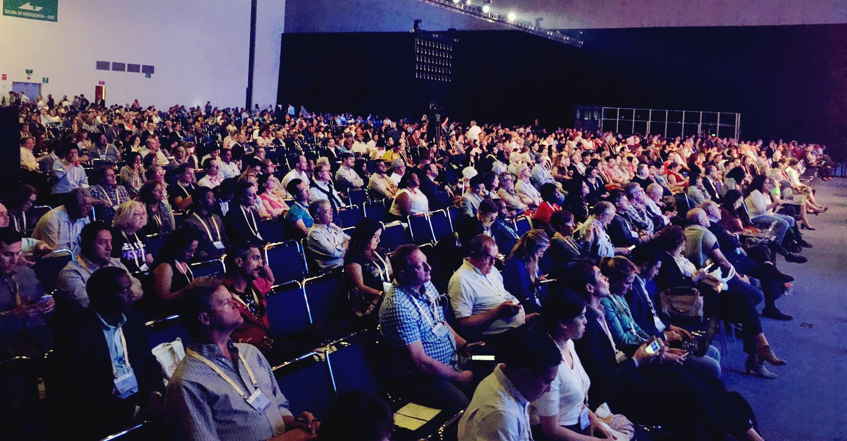
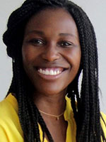
THANK YOU!
Chloe Orkin
Tristan Barber
Graeme Moyle
Simon Collins

Slide 23
Safe travels home!

